Slide 1
Capstone Project-1
Superstore Sales Data
Team Members
Vaibhav 2210992488
Ujjwal 2210992478 Utsav 2210992484
Tushar 2210992470
Notes:
Data

Slide 2
CONTENT
Problem Statement
Objective
Tools Used
Data Summary
Feature Engineering & Data Pre-processing
Feature Manipulation & Selection
Data Scaling
Data Splitting
ML Model Implementation
Conclusions
Q & A

Slide 3
PROBLEM STATEMENT
The Superstore Sales Data consists of various attributes such as order details, customer information, product categories, sales figures, and geographical information. The goal is to leverage this dataset to gain insights that will help improve business performance, optimize operations, and enhance customer satisfaction.

Slide 4
Objectives
Analyze sales trends over time: Investigate patterns and trends in sales figures over different time periods (e.g., daily, monthly, yearly) to identify seasonal variations, growth trends, and potential areas for improvement.
Understand customer segmentation: Explore customer segments based on demographics, purchase behavior, and geographic location. Identify high-value customer segments and tailor marketing strategies to better serve their needs.

Slide 5
Tools Used
Google collab is used as IDE.
Pandas and NumPy are used for Data Manipulation & Pre-processing and Mathematical functions respectively.
Exploratory data analysis is automated by data prep.
For visualization of the plots, Matplotlib, Seaborn, Plotty are used.
GitHub is used as version control system

Slide 6

DATA SUMMARY
Categorical Data
Category
Sub category
State
City
Region
Country
Segment
Ship Mode
Numerical Data
Sales
Order Date
Ship Date
Profit
Discount
Unique Data
Sales
Row Id
Postal Code

Slide 7
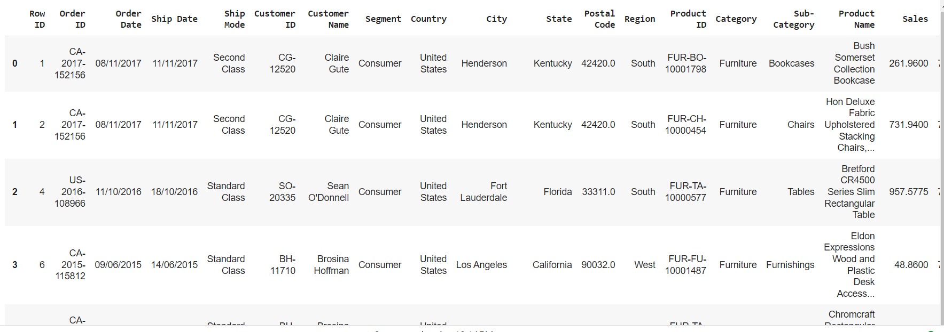
DATA SUMMARY
This is the Superstore Sale dataset. In the below table it shows the top 3 rows

Slide 8

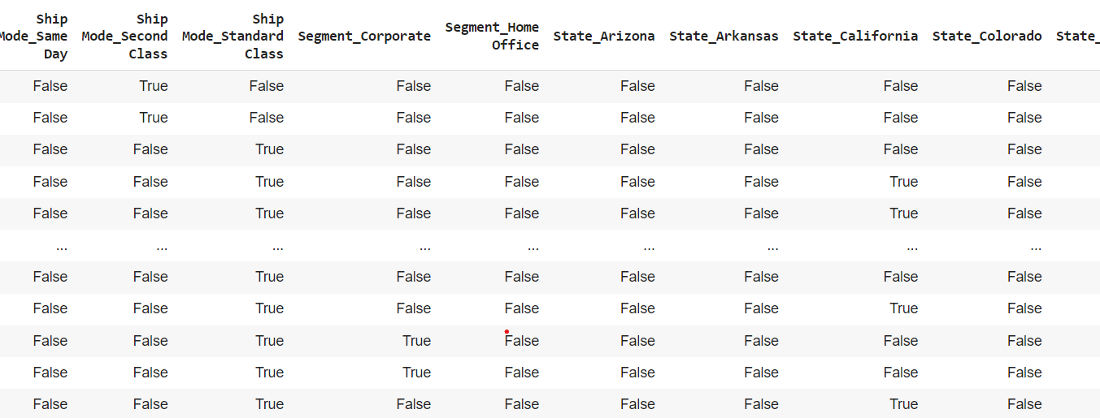
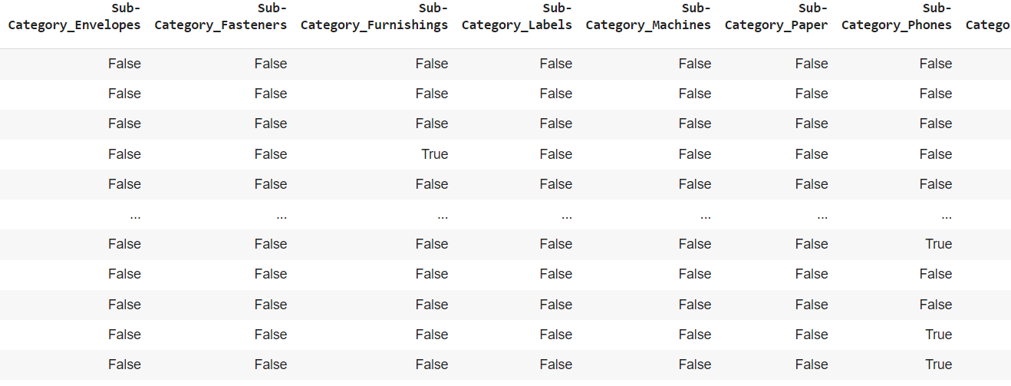
Feature Engineering & Data Pre-processing
1. Handling Missing Values
2. Categorical Encoding (One Hot)

Slide 9
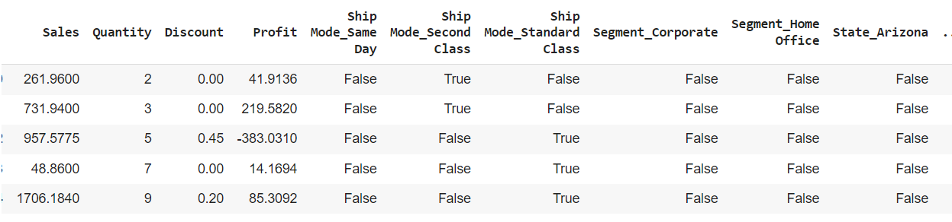
Feature Manipulation & Selection
1. Feature Manipulation

Slide 10
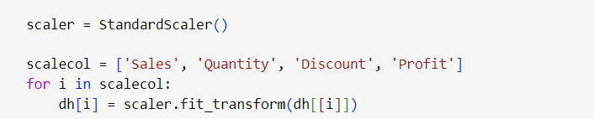
Data Scaling
StandardScaler from scikit-learn library is used to scale the data. The StandardScaler scales each feature by subtracting the mean and dividing by the standard deviation, which results in a distribution with a mean of 0 and a standard deviation of 1
It is less sensitive or more robust to outliers compared to other scaling methods like min-max scaling that's why we have used it here

Slide 11
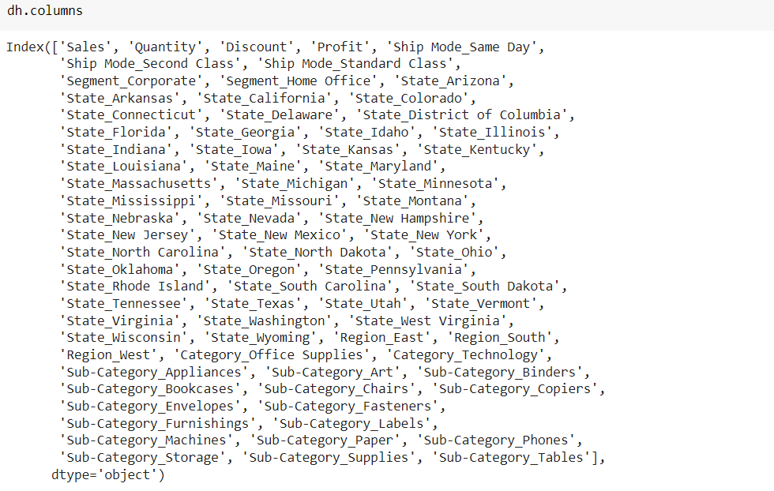
Columns

Slide 12
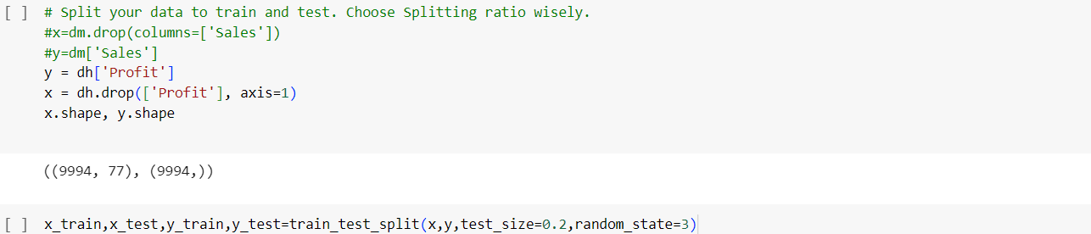
Data Splitting

Slide 13
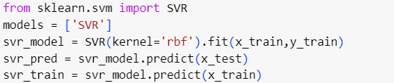
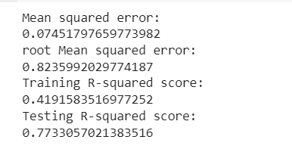
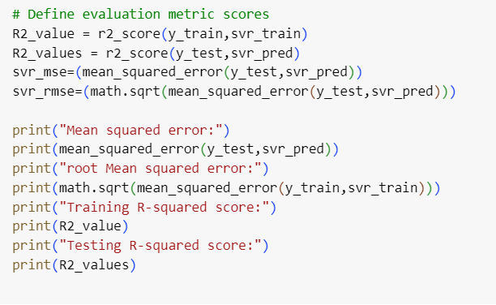
6. ML Model Implementation
ML Model - I
Support Vector Regressor (SVR):
Algorithm: SVR is a supervised learning algorithm used for regression tasks. It works by finding the hyperplane that best fits the data, with a margin that aims to minimize the error between the actual and predicted values while controlling for overfitting.

Slide 14
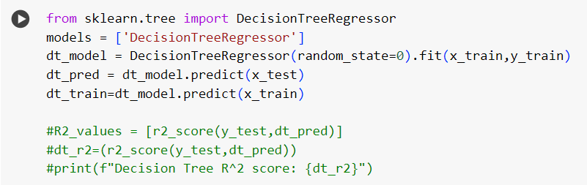
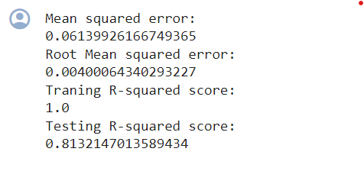
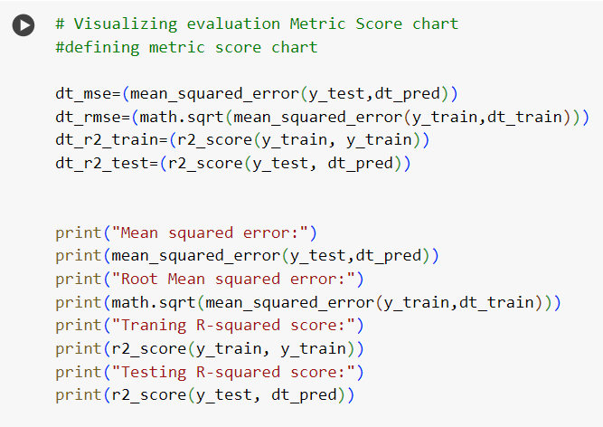
6. ML Model Implementation
ML Model - II
Decision Tree Regressor:
Algorithm: Decision trees partition the feature space into regions, with each region representing a simple decision rule. These rules are learned from the training data by recursively splitting the data based on the feature that best separates the target variable.

Slide 15
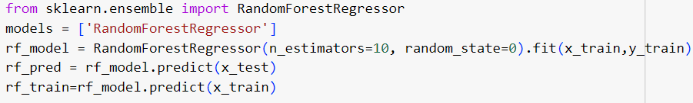
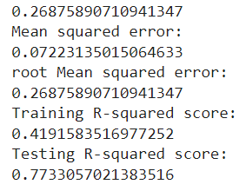
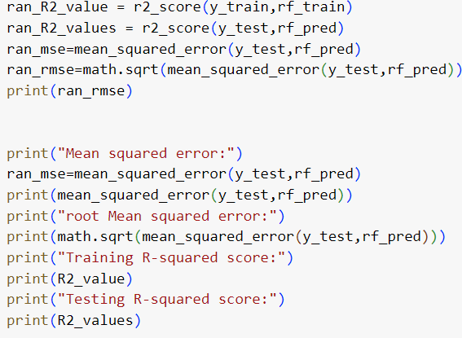
6. ML Model Implementation
ML Model - III
Random Forest Regressor:
Algorithm: Random Forest works by building multiple decision trees during training. Each tree is trained on a subset of the data and a random subset of features. This randomness helps to decorrelate the trees and reduces overfitting.

Slide 16
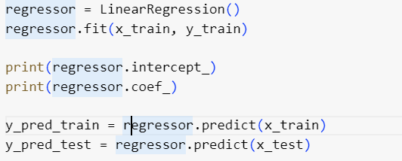
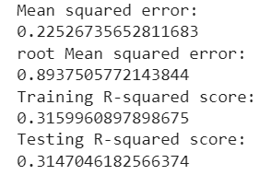
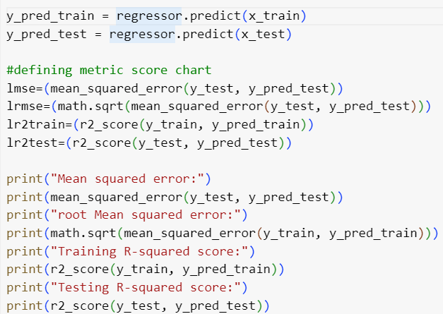
6. ML Model Implementation
ML Model - IV
Linear Regression:
Algorithm:

Slide 17
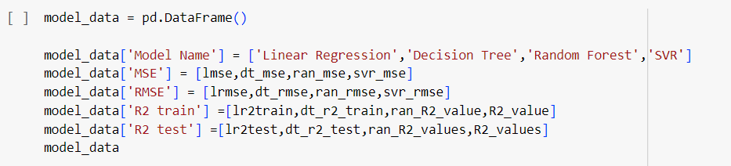
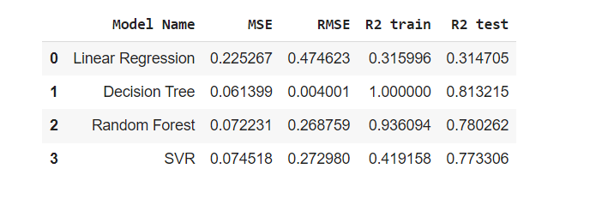
Conclusion

Slide 18
Questions
Q. Which ML model did you choose from the above created models as your final prediction model and why?
Ans: I will choose Decision tree for future prediction as its r2 score is 1 for training set and for testing set it is 0.81 which is very high accuracy
Q. Explain the model which you have used and the feature importance using any model explainability tool?
Ans Decision Tree Algorithm:
Decision tree is a supervised learning algorithm used for both classification and regression tasks.
It works by recursively partitioning the feature space into subsets based on the values of features, creating a tree-like structure where each internal node represents a decision based on a feature, and each leaf node represents a predicted outcome.
The splitting process aims to maximize the homogeneity (purity) of the subsets with respect to the target variable.
Feature Importance Analysis:
Gini Importance or Mean Decrease in Impurity (MDI): One common method for determining feature importance in decision trees is to measure how much each feature contributes to decreasing impurity (Gini impurity or entropy) across all nodes where it is used for splitting.
Features that lead to the greatest reduction in impurity are considered more important.

